Slide 1
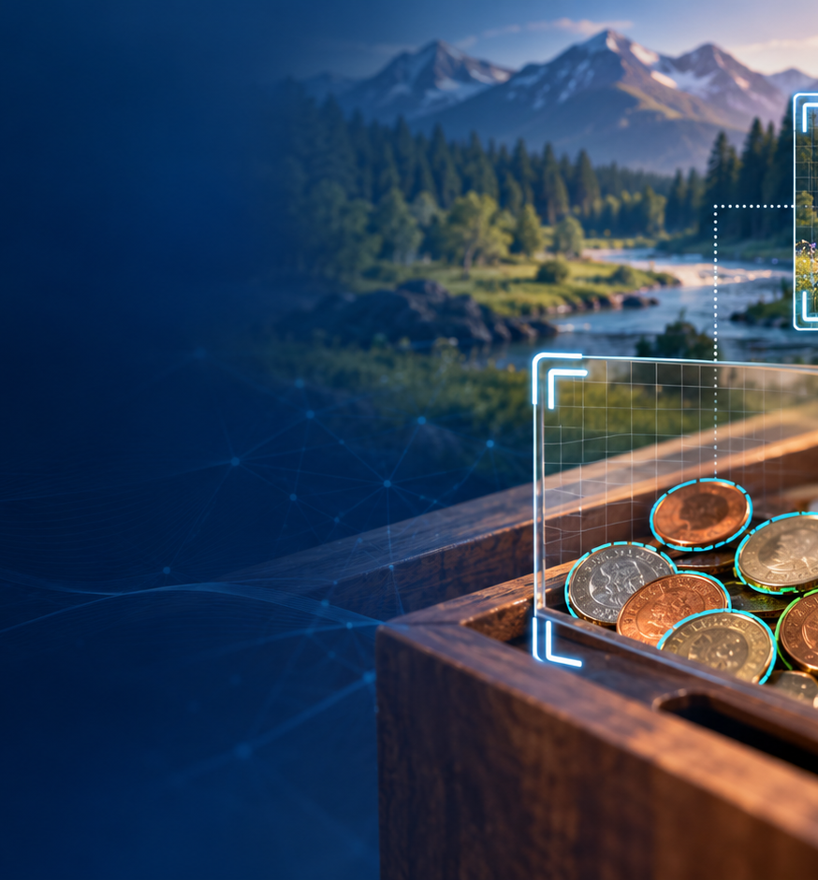
WEEK 7 CONCEPTUAL RETAKE
Computer Vision
The computer-vision concepts and activities from Week 7
Attendance resit presentation
Max Lopez

Slide 2
01 PERSONAL EXPERIMENT
Teachable Machine task
1
Choose 3 classes
Use distinct objects or gestures you can explain.
2
Capture 30+ each
Vary angle, distance, background and lighting.
3
Train and test
Include examples unlike the training images.
4
Save evidence
Screenshot class counts, results and one real failure.
5
Explain the cause
Connect the error to data, preprocessing or context.
Evidence: class counts, test result and one real failure.
Max Lopez Attendance resit Week 7
02

Slide 3
02 AI FOR GOOD
Two uses of computer vision
DIABETIC RETINOPATHY
WILDLIFE CAMERA TRAPS
Use: screen retinal images for disease
Benefit: faster review for more people
Risk: results change across devices and populations
Safeguard: local testing and clinician review
Use: sort wildlife camera-trap images
Benefit: faster ecological monitoring
Risk: rare species and new habitats are missed
Safeguard: check low-confidence results
For both examples, test who benefits, who may be missed, and when a person checks the result.
Max Lopez Attendance resit Week 7
03
Notes:
Source: https://jamanetwork.com/journals/jama/fullarticle/2665775
Source: https://research.google/blog/where-wild-things-roam-identifying-wildlife-with-speciesnet/

Slide 4
03 PREPROCESSING
Image preprocessing
01
02
03
04
Pixels
Resize or crop
Grayscale
Normalise
An image is a grid of height × width × colour values
Fits the model, but can hide small details or context
Uses less data, but removes colour clues
Puts values on one scale, but camera differences can remain
Use the same preprocessing for training and real images, then test what information was lost.
Max Lopez Attendance resit Week 7
04

Slide 5
04 NEURAL FEATURES
How a neural network learns image features
EARLY LAYERS
LATER LAYERS
Training compares a prediction with the correct label
The weights change after each error
Early layers learn edges and textures
Later layers combine parts and shapes
Images change with light, angle, and background
Background shortcuts can cause errors
Test new angles, lighting, and backgrounds instead of trusting confidence alone.
Max Lopez Attendance resit Week 7
05

Slide 6
05 CONVOLUTION
Convolution step by step
01
02
03
04
Patch
Multiply
Sum
Slide
Take a small window of nearby pixels
Apply learned filter weights
Produce one activation value
Repeat to create a feature map
The same filter checks every part of the image. This helps a CNN find a pattern wherever it appears.
Max Lopez Attendance resit Week 7
06

Slide 7
06 BEYOND PHOTOGRAPHS
CNN example using non-image data
INPUT
STRUCTURE
An ECG is a heart signal recorded as numbers over time.
Nearby values form local heartbeat shapes.
CONVOLUTION
OUTPUT
A one-dimensional filter scans short parts of the signal.
The model can flag heartbeat types for clinician review.
Max Lopez Attendance resit Week 7
07
Notes:
Source: https://pubmed.ncbi.nlm.nih.gov/26285054/

Slide 8
07 MY EXPERIMENT
My Teachable Machine test
Class
Training images
Test result
What I noticed
Class 1
30+
Add result
Add observation
Class 2
30+
Add result
Add observation
Class 3
30+
Add result
Add observation
Failure example
—
Add result
Why did it fail?
Screenshot
—
Add filename
Shows all 3 classes
Max Lopez Attendance resit Week 7
08

